Slide 1


Le Mans Université
Master Informatique 1ère année
Programmation d'Interfaces Embarquées
TABOO
BOOKING TABLE HAS NEVER BEEN SO EASY
Basan Dmytro Matviienko Serhii

Slide 2

What is it?
Log in with Google Account
Select a restaurant on the map
Choose your table
Book a convenient time
Have a good time

Slide 3
What can you book?
Restaurants
Cafes
Bars
Night Clubs

Slide 4
Technologies
MVC
Android SDK
Google API
Google Login
Google Maps
Picasso

Slide 5
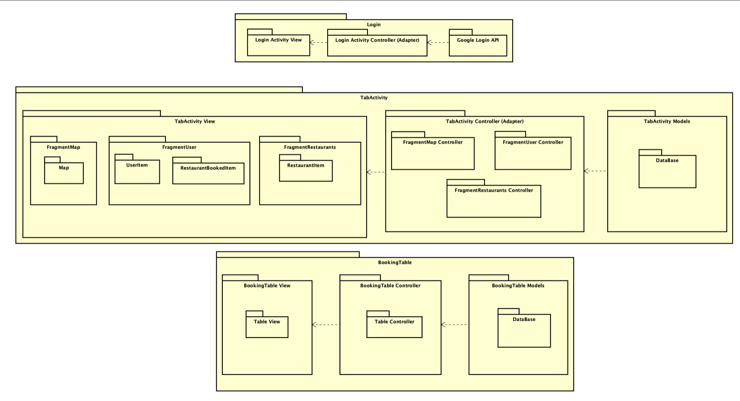
MVC

Slide 6
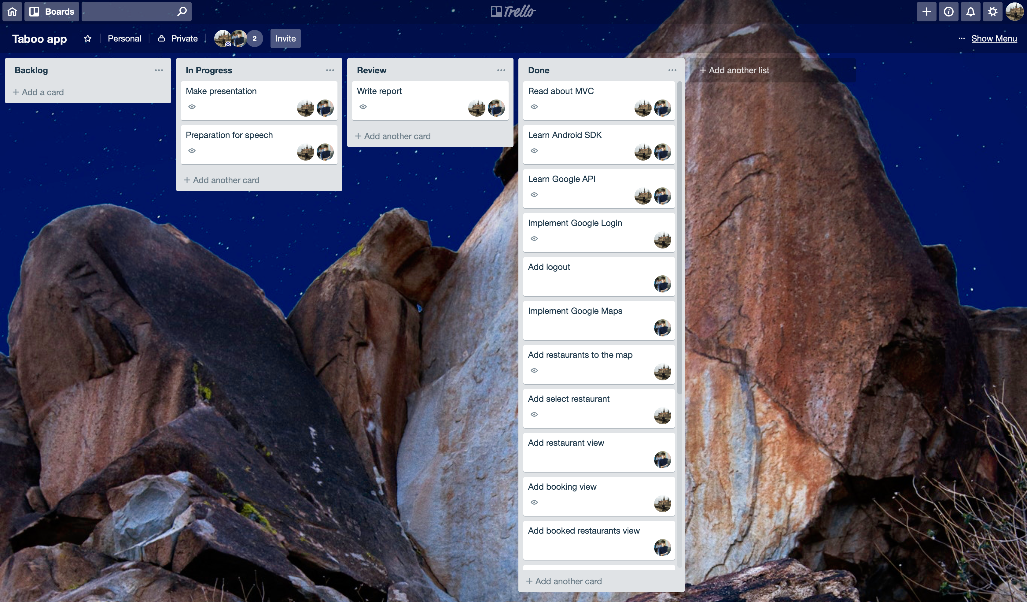
Trello

Slide 7
Work Breakdown
Activity | Dmytro | Serhii | Total
Preparation for developing | 50 | 50 | 100
Connect Google SDK | 60 | 40 | 100
Adding view | 50 | 50 | 100
Look over architecture | 40 | 60 | 100
Work with map | 70 | 30 | 100
Work with Google API | 20 | 80 | 100
Fix errors/bugs while developing | 60 | 40 | 100
Write report | 30 | 70 | 100
Make presentation | 70 | 30 | 100
Preparation for speech | 50 | 50 | 100
Global work done | 50 | 50 | 100

Slide 8
Presentation of our app

Slide 9
Thank you for your attention!

